Slide 1



VOIS Innovation
Marathon 2.0

Slide 2



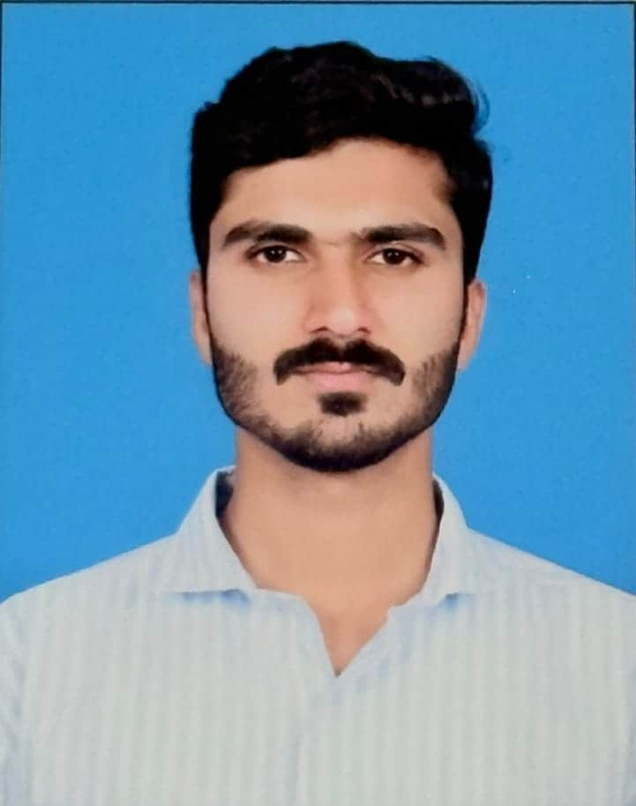
Project Title : SMART DRONE FOR ANIMAL DETECTION AND TRACKING
Insert your professional photo
Team No - 53
Team Lead – Furqan S Bellary
(Electronics and Communication Engineering)
Afsaa Banu T A
(Electronics and Communication Engineering)​
Aman Shaikh
(Electronics and Communication Engineering)​
JSS Academy of Technical Education

Slide 3

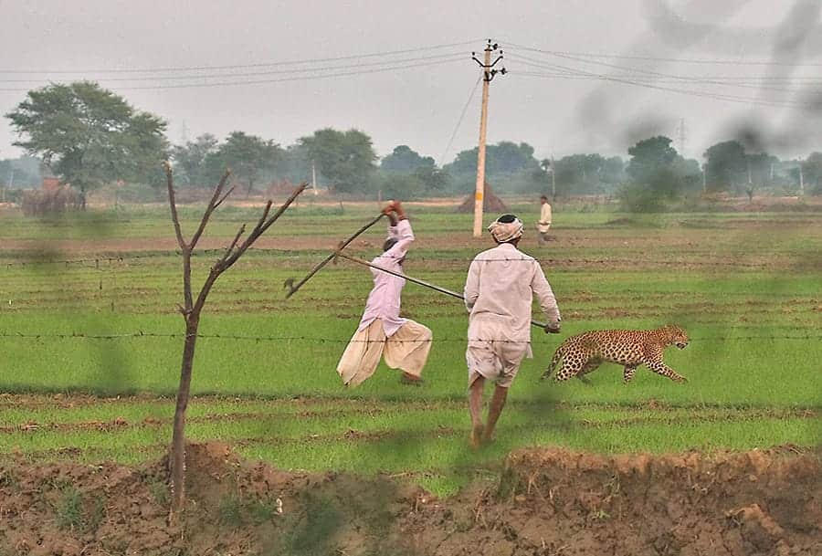
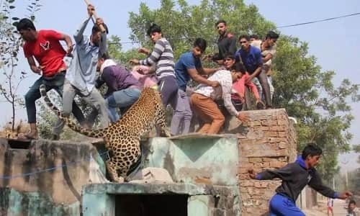
Problem Statement
"To develop an AI-powered smart drone for real-time wild animal detection, tracking, and alerting to reduce human–wildlife conflict "
Fig 1.Human Wildlife Conflict In Rural And Forest Adjacent Areas

Slide 4
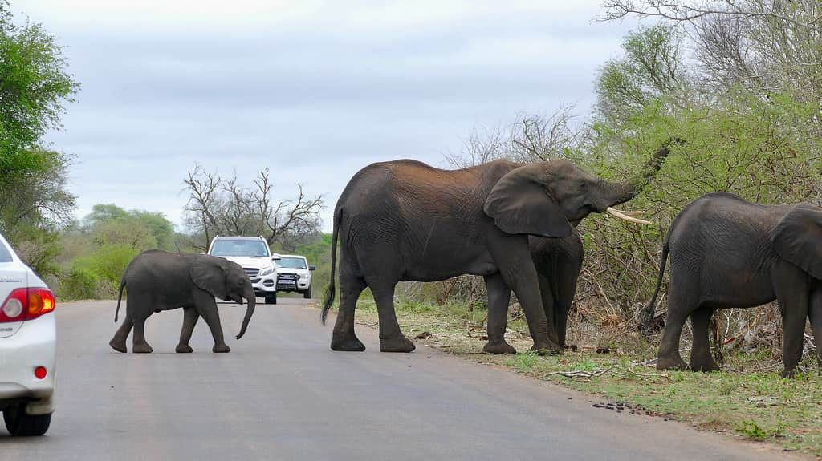
Need of Project
1
Escalating Conflict: Urban growth drives wildlife into towns, causing public panic.
Surveillance Failures: Slow monitoring fails to detect dangerous nighttime intrusions.
Economic Threat: Crop raids destroy livelihoods and local food security.
Mutual Safety: Non-lethal tools are needed to protect both people and wildlife.
2
3
4
Fig 2. Wildlife Crossing Public Roads

Slide 5
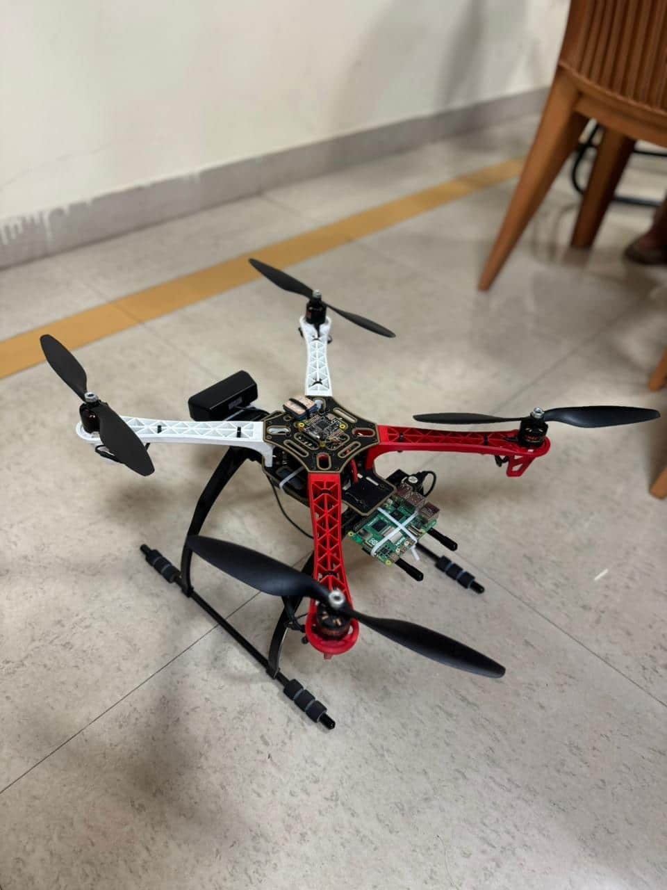
Proposed Solution
Intelligent Onboard Detection: A Raspberry Pi with AI identifies wildlife instantly on the drone.
Instant Deterrence: Drones trigger local speaker alarms the moment a threat is detected.
Real-Time Communication: A GSM module sends automated mobile notifications simultaneously.
We propose a smart drone system that acts as an automated "eye in the sky" to stop wildlife conflict before it happens.
Fig 3. Assembled Drone Prototype

Slide 6
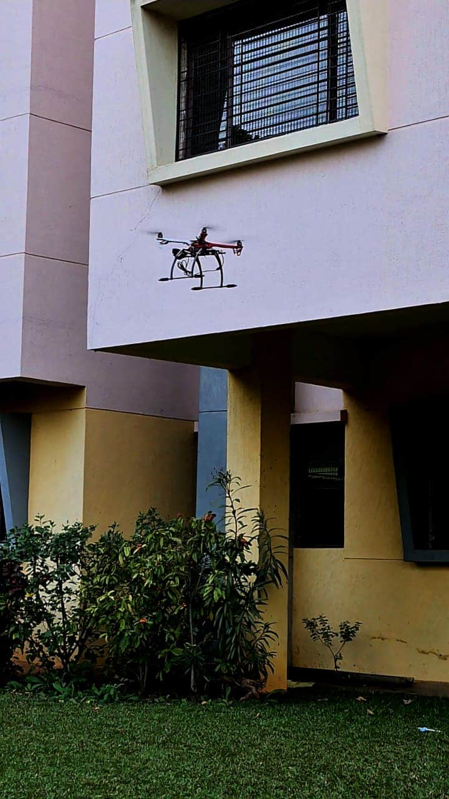
Solution Overview
1
Flying AI surveillance that detects wild animals in real time, not fixed cameras.
Smart differentiation between wild and domestic animals, reducing false alarms.
Instant deterrence + GPS-based alerts, enabling faster and more accurate response before damage occurs.
2
3
Fig 4. Drone Flight Testing And Surveillance

Slide 7
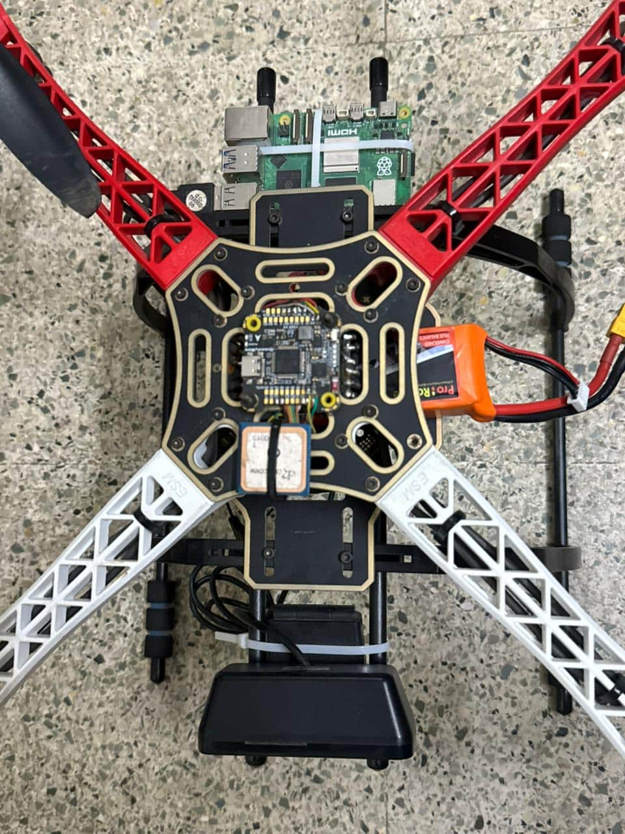
Technology used
1
Processing & Edge AI
Raspberry Pi 5
YOLOv8n
Computer Vision & Imaging
HD Cameras
Communication & Tracking
GPS Module
Deterrence & Output
Acoustic Alarms
Automated Notification System
2
3
4
Fig 5. Autonomous Surveillance Quadcopter

Slide 8
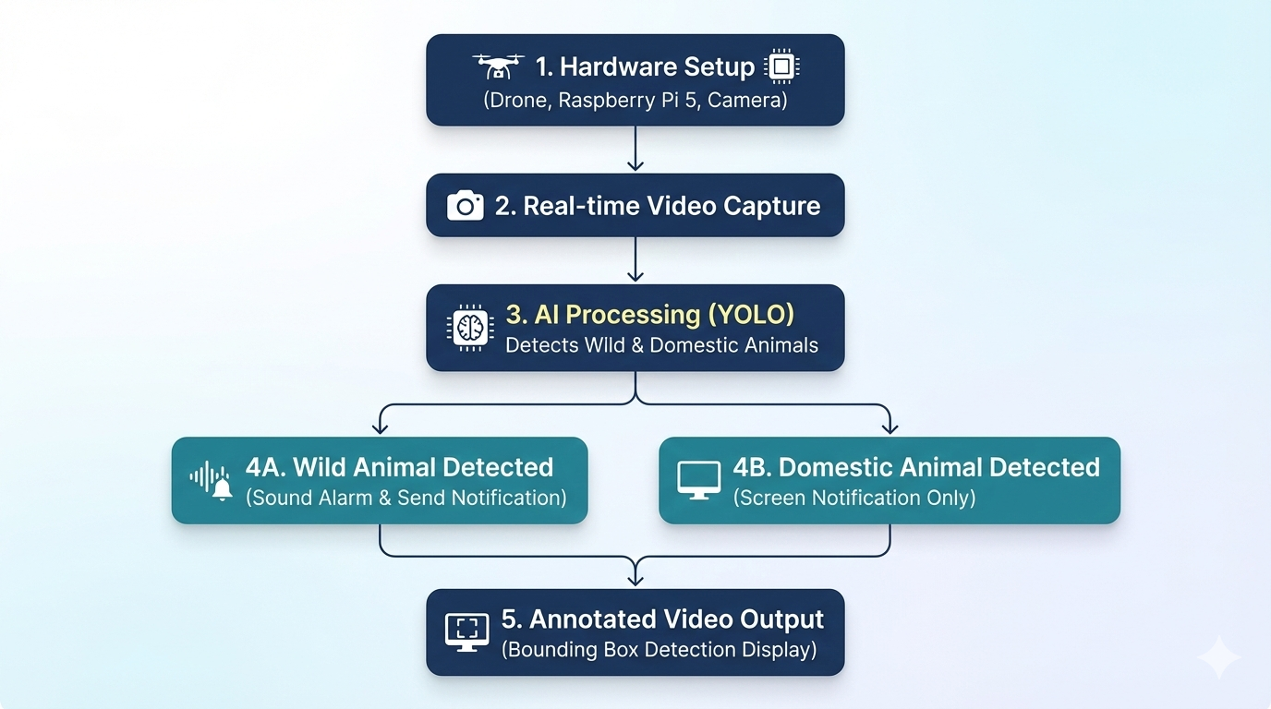
Technical flow diagram -

Slide 9
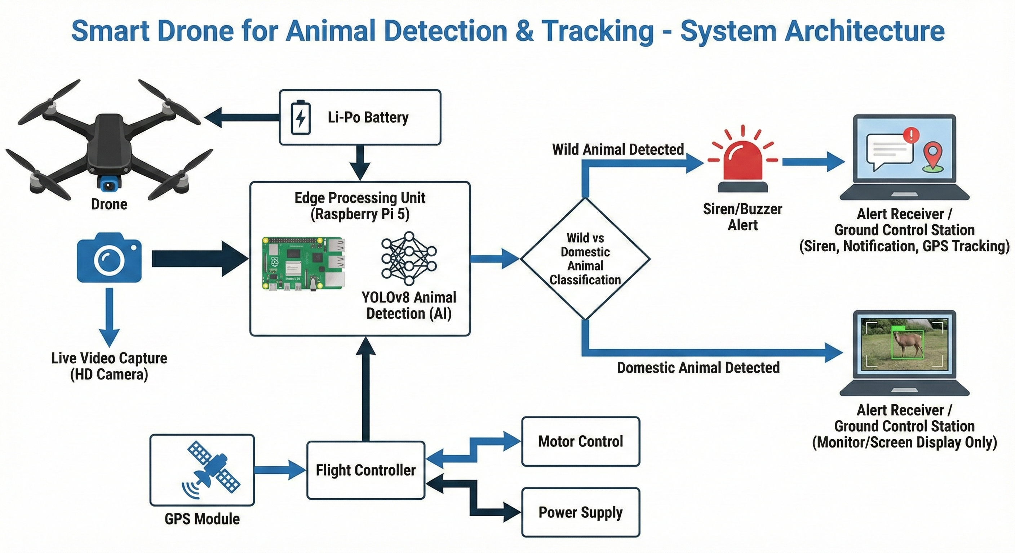
Architecture Blueprint

Slide 10
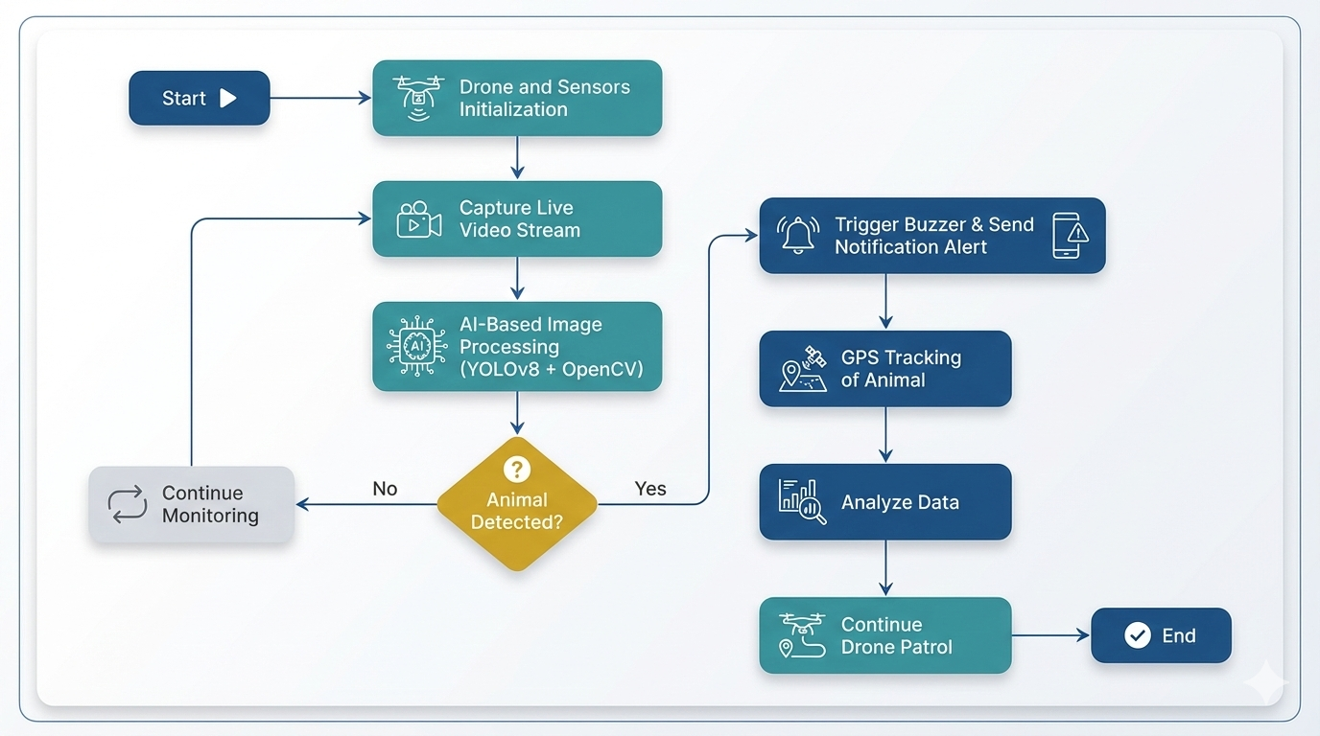
Workflow diagram

Slide 11
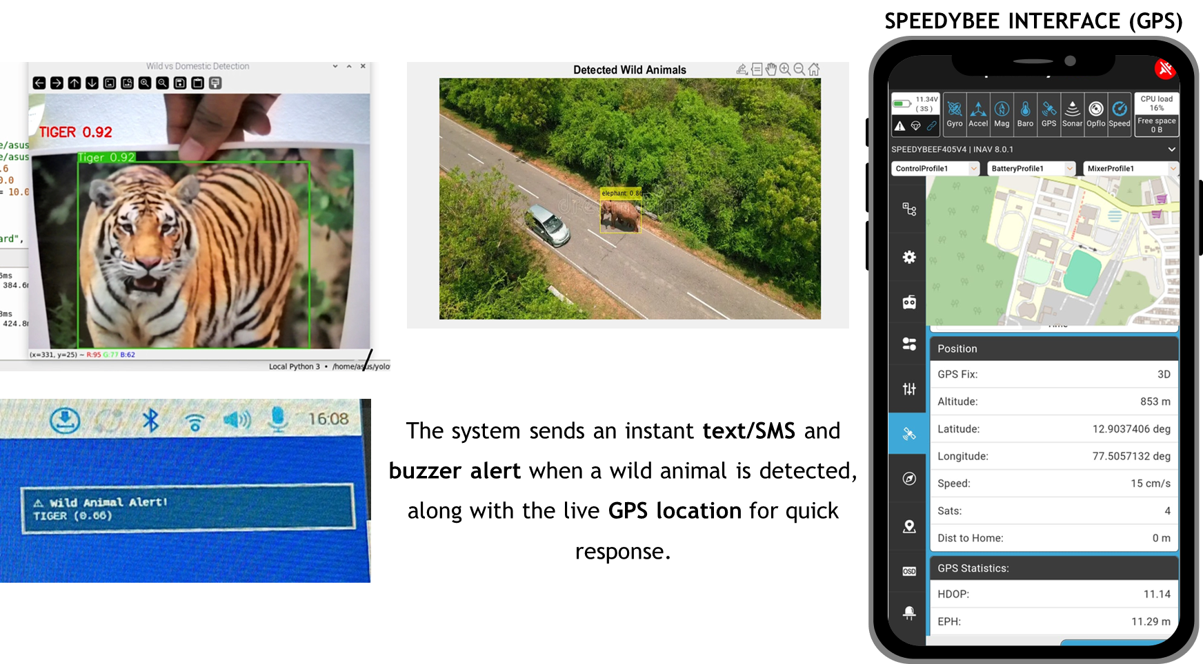
RESULTS​
​

Slide 12
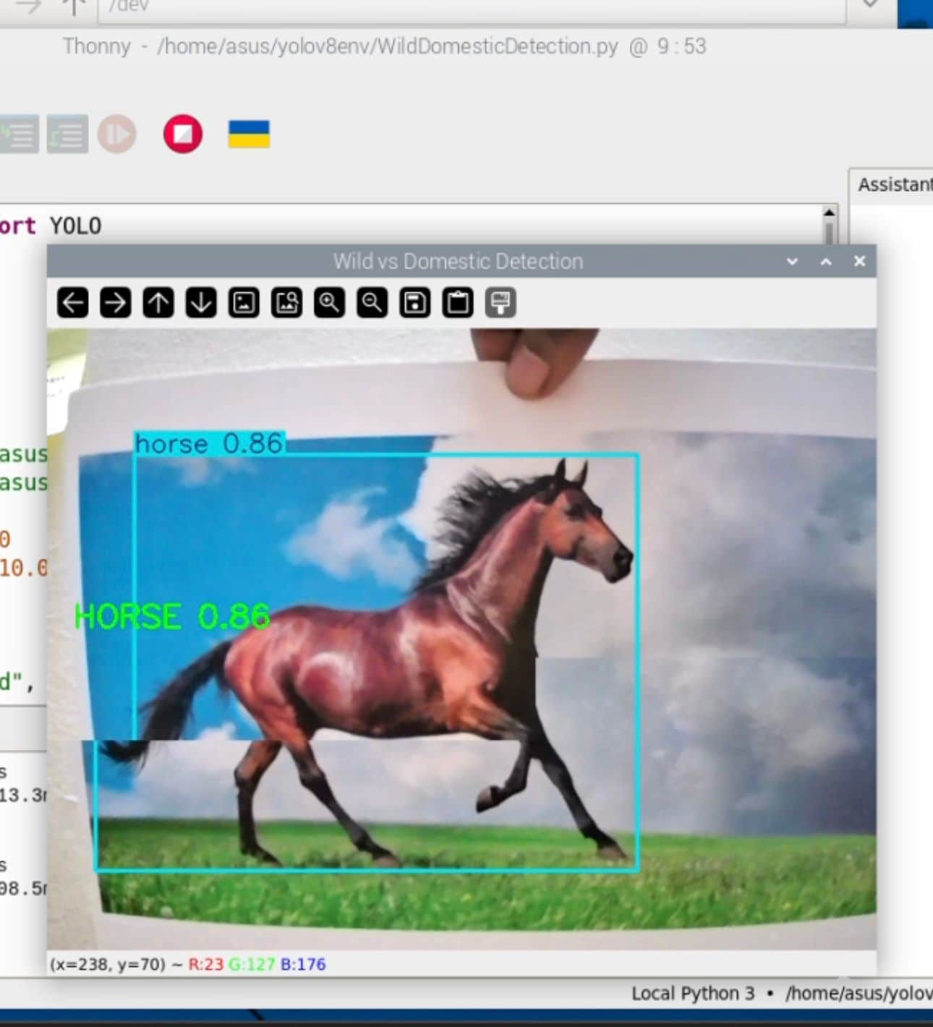
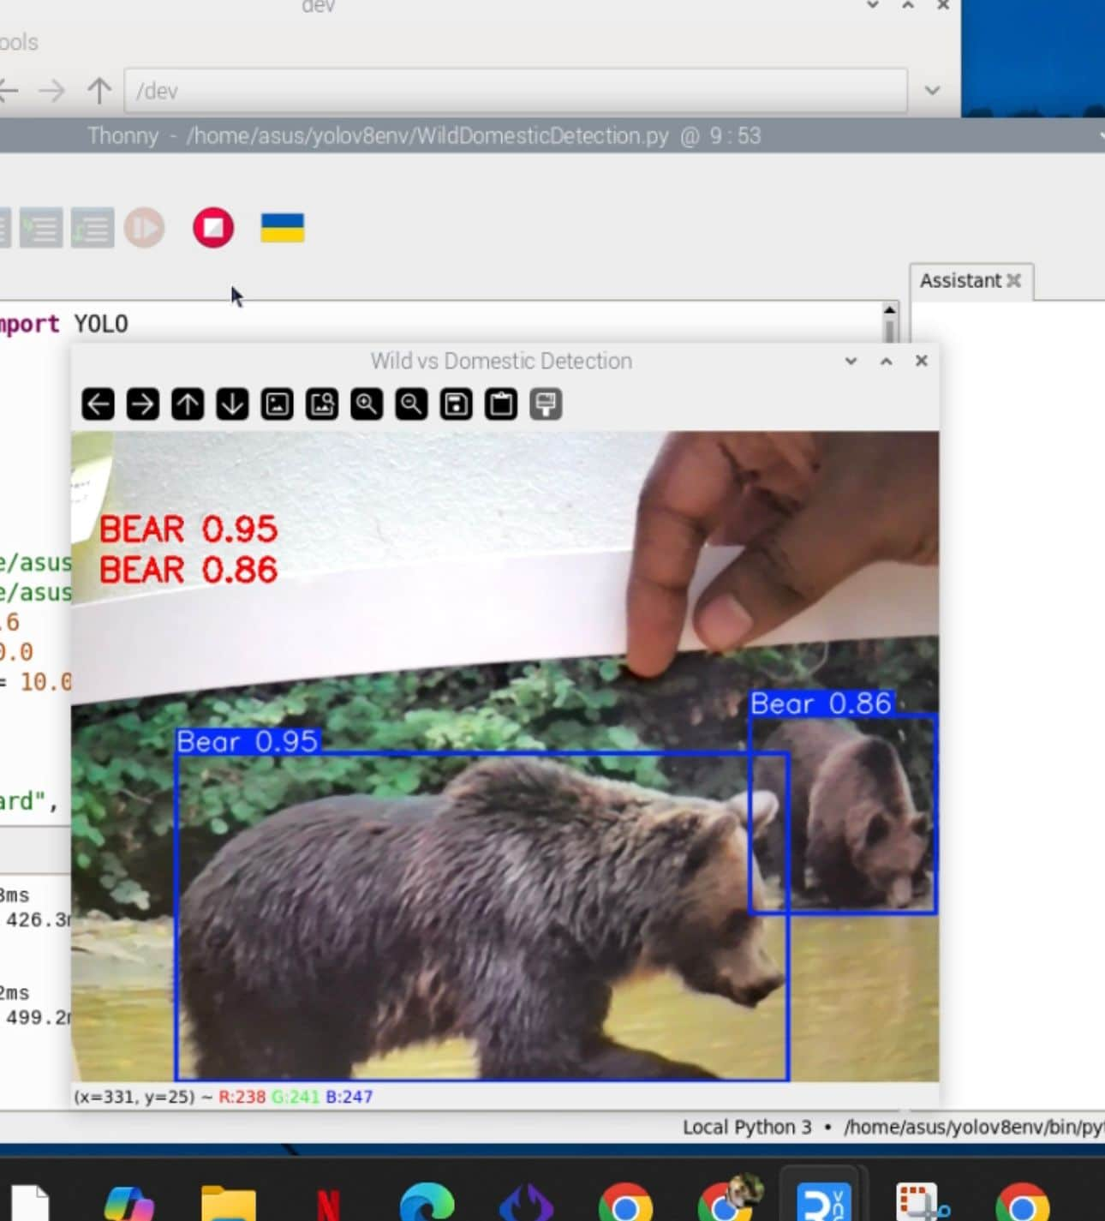
RESULTS​
​
"Detection of domestic animal but no alarm"
"Detection of wild animal with alarm"

Slide 13
Novelty and Uniqueness
1
2
3
4
On-board AI for real-time wildlife detection without needing the cloud.
AI detects threats to trigger alarms and send instant GPS alerts.
Robust, high accuracy animal detection in diverse environmental conditions.
Fast detection triggers immediate non-lethal alarms and alerts officials.

Slide 14
Git Hub Link
https://github.com/furqanbellary234/Smart-drone-for-animal-detection-and-tracking-

Slide 15
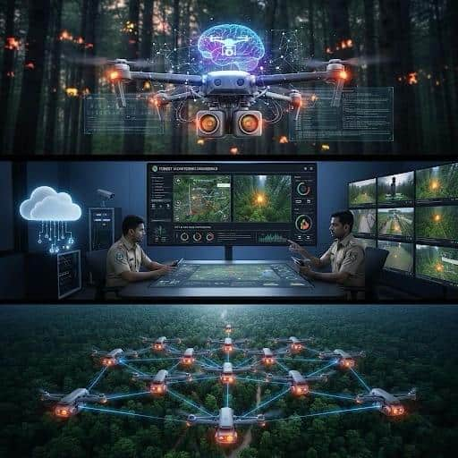
Future Scope
Integration of Thermal Cameras
Improved AI Models
Autonomous Drone Navigation
Cloud-based Monitoring Dashboard
Swarm Drone Technology
Integration with Forest Department Networks
CCTV integration
Fig 6. Future Scope

Slide 16
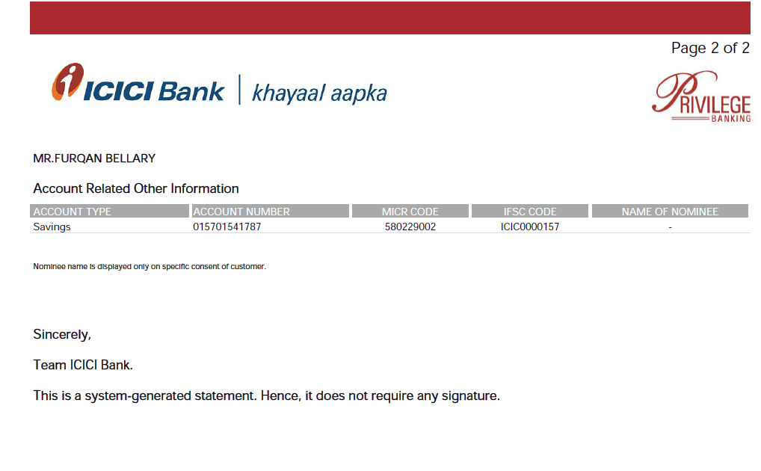
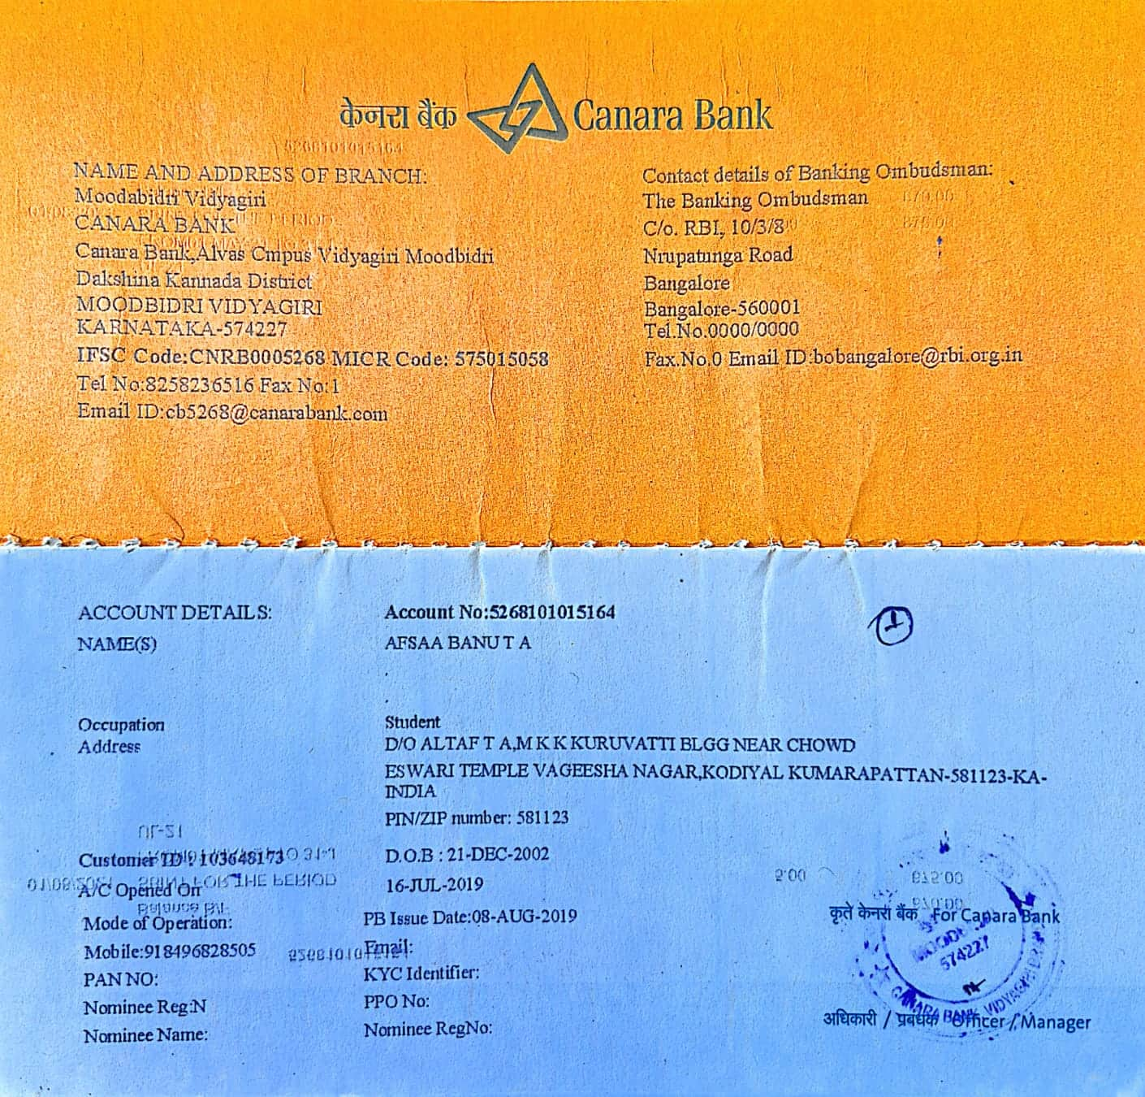
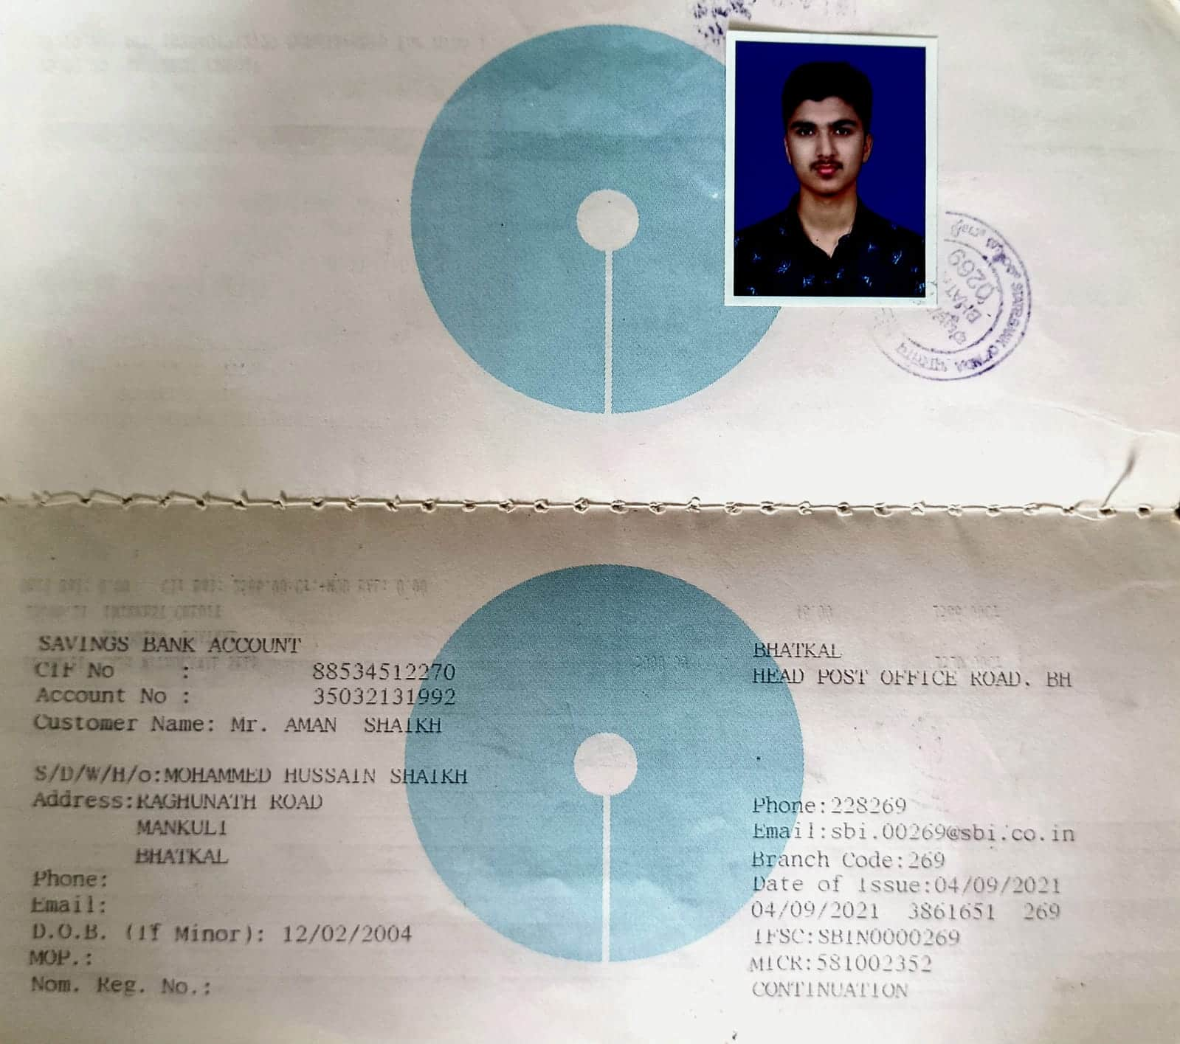
Bank Details
Full Name (as per bank records): | Bank Name | Branch Name | Account Number | Account Type (Savings / Current) | IFSC Code
Furqan S Bellary | ICICI BANK | HUBLI | 015701541787 | SAVINGS | ICIC0000157
Afsaa Banu T A | CANARA BANK | MOODBIDRI VIDYAGIRI | 5268101015164 | SAVINGS | CNRB0005268
Aman Shaikh | STATE BANK OF INDIA | BHATKAL | 35032131992 | SAVINGS | SBIN0000269
Insert photo of passbook / bank statement
Insert photo of passbook / bank statement
FURQAN S BELLARY
AFSAA BANU T A
AMAN SHAIKH

Slide 17
Thank You

